Slide 1
AI for Medicine
Lecture 3:
AI Applications in Medicine – Part II
January 24, 2022
Mohammad Hammoud
Carnegie Mellon University in Qatar

Slide 2
Today…
Last Monday’s Session:
Introduction to AI
Today’s Session:
AI Applications in Medicine – Part I
Announcement:
Assignment 1 will be out by tonight and is due on Tuesday, Jan 25th by midnight

Slide 3
Outline
Introduction
What is AI?
Administrivia
AI Applications in Medicine

Slide 4
Some Applications of AI in Medicine
Diagnosing diabetic eye disease using deep learning [1]
Detecting anemia from retinal fundus images using deep learning [2]
Predicting cardiovascular risk factors from retinal fundus photographs using deep learning [3]
Extracting symptoms and their status from clinical conversations using recurrent neural networks [4]
Performing differential diagnosis using probabilistic graphical models [5]
Predicting osteoarthritis using machine learning [6]

Slide 5
Some Applications of AI in Medicine
Diagnosing diabetic eye disease using deep learning [1]
Detecting anemia from retinal fundus images using deep learning [2]
Predicting cardiovascular risk factors from retinal fundus photographs using deep learning [3]
Extracting symptoms and their status from clinical conversations using recurrent neural networks [4]
Performing differential diagnosis using probabilistic graphical models [5]
Predicting osteoarthritis using machine learning [6]

Slide 6
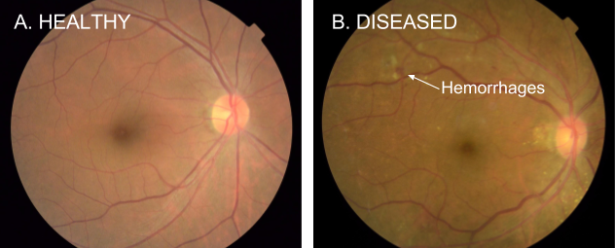
Diagnosing Diabetic Eye Disease Using Deep Learning
Diabetic retinopathy (DR) is the fastest growing cause of blindness, with nearly 451 million diabetic patients at risk worldwide
One of the most common ways to detect DR is to have a specialist examine eye pictures and rate them for disease presence and severity

Slide 7
Diagnosing Diabetic Eye Disease Using Deep Learning
If DR is caught early, the disease can be treated; if not, it can lead to irreversible blindness
As such, regular screening is essential for the early detection of DR
Unfortunately, medical specialists capable of detecting DR are not available in many parts of the world where diabetes is prevalent
Google has developed a deep learning algorithm capable of interpreting signs of DR in retinal photographs

Slide 8
Diagnosing Diabetic Eye Disease Using Deep Learning
They created a dataset of 128,000 images, each labeled by 3-7 ophthalmologists from a panel of 54 ophthalmologists
DR severity (none, mild, moderate, severe, or proliferative) was graded according to the International Clinical Diabetic Retinopathy scale
They then used this dataset to train a deep learning algorithm to detect referable diabetic retinopathy
Afterwards, they tested the algorithm on two clinical validation sets totaling ~12,000 images, with a panel of 7-8 U.S. board-certified ophthalmologists serving as the reference standard

Slide 9
Diagnosing Diabetic Eye Disease Using Deep Learning
The F-score (combined sensitivity and precision) of the algorithm was 0.95, which is slightly better than the median F-score of the 8 board-certified ophthalmologists (measured at 0.91)
Gold Standard
 | DR | No DR
DR
No DR
Predicted
by the classifier
A confusion matrix for visualizing how well a binary classifier (DR vs. No DR) performs against the ground truth (or gold standard)

Slide 10
Diagnosing Diabetic Eye Disease Using Deep Learning
The F-score (combined sensitivity and precision) of the algorithm was 0.95, which is slightly better than the median F-score of the 8 board-certified ophthalmologists (measured at 0.91)
Gold Standard
 | DR | No DR
DR | True Positive
No DR
Predicted
by the classifier

Slide 11
Diagnosing Diabetic Eye Disease Using Deep Learning
The F-score (combined sensitivity and precision) of the algorithm was 0.95, which is slightly better than the median F-score of the 8 board-certified ophthalmologists (measured at 0.91)
Gold Standard
 | DR | No DR
DR | True Positive
No DR
Predicted
by the classifier

Slide 12
Diagnosing Diabetic Eye Disease Using Deep Learning
The F-score (combined sensitivity and precision) of the algorithm was 0.95, which is slightly better than the median F-score of the 8 board-certified ophthalmologists (measured at 0.91)
Gold Standard
 | DR | No DR
DR | True Positive
No DR | False Negative
Predicted
by the classifier

Slide 13
Diagnosing Diabetic Eye Disease Using Deep Learning
The F-score (combined sensitivity and precision) of the algorithm was 0.95, which is slightly better than the median F-score of the 8 board-certified ophthalmologists (measured at 0.91)
Gold Standard
 | DR | No DR
DR | True Positive
No DR | False Negative
Predicted
by the classifier

Slide 14
Diagnosing Diabetic Eye Disease Using Deep Learning
The F-score (combined sensitivity and precision) of the algorithm was 0.95, which is slightly better than the median F-score of the 8 board-certified ophthalmologists (measured at 0.91)
Gold Standard
 | DR | No DR
DR | True Positive | False Positive
No DR | False Negative
Predicted
by the classifier

Slide 15
Diagnosing Diabetic Eye Disease Using Deep Learning
The F-score (combined sensitivity and precision) of the algorithm was 0.95, which is slightly better than the median F-score of the 8 board-certified ophthalmologists (measured at 0.91)
Gold Standard
 | DR | No DR
DR | True Positive | False Positive
No DR | False Negative
Predicted
by the classifier

Slide 16
Diagnosing Diabetic Eye Disease Using Deep Learning
The F-score (combined sensitivity and precision) of the algorithm was 0.95, which is slightly better than the median F-score of the 8 board-certified ophthalmologists (measured at 0.91)
Gold Standard
 | DR | No DR
DR | True Positive | False Positive
No DR | False Negative | True Negative
Predicted
by the classifier

Slide 17
Diagnosing Diabetic Eye Disease Using Deep Learning
The F-score (combined sensitivity and precision) of the algorithm was 0.95, which is slightly better than the median F-score of the 8 board-certified ophthalmologists (measured at 0.91)
Gold Standard
 | DR | No DR
DR | True Positive | False Positive
No DR | False Negative | True Negative
Predicted
by the classifier

Slide 18
Diagnosing Diabetic Eye Disease Using Deep Learning
The F-score (combined sensitivity and precision) of the algorithm was 0.95, which is slightly better than the median F-score of the 8 board-certified ophthalmologists (measured at 0.91)
Gold Standard
 | DR | No DR
DR | True Positive | False Positive
No DR | False Negative | True Negative
Predicted
by the classifier
% of correct cases (i.e., with DR) that are predicted as DR

Slide 19
Diagnosing Diabetic Eye Disease Using Deep Learning
The F-score (combined sensitivity and precision) of the algorithm was 0.95, which is slightly better than the median F-score of the 8 board-certified ophthalmologists (measured at 0.91)
Gold Standard
 | DR | No DR
DR | True Positive | False Positive
No DR | False Negative | True Negative
Predicted
by the classifier
% of correct cases (i.e., with DR) that are predicted as DR =
Recall = $\frac{True Positive}{True Positive+False Negative}$

Slide 20
Diagnosing Diabetic Eye Disease Using Deep Learning
The F-score (combined sensitivity and precision) of the algorithm was 0.95, which is slightly better than the median F-score of the 8 board-certified ophthalmologists (measured at 0.91)
Gold Standard
 | DR | No DR
DR | True Positive | False Positive
No DR | False Negative | True Negative
Predicted
by the classifier
The algorithm’s ability to designate an individual with DR as positive =
Recall = $\frac{True Positive}{True Positive+False Negative}$

Slide 21
Diagnosing Diabetic Eye Disease Using Deep Learning
The F-score (combined sensitivity and precision) of the algorithm was 0.95, which is slightly better than the median F-score of the 8 board-certified ophthalmologists (measured at 0.91)
Gold Standard
 | DR | No DR
DR | True Positive | False Positive
No DR | False Negative | True Negative
Predicted
by the classifier
The algorithm’s ability to designate an individual with DR as positive =
Recall = $\frac{True Positive}{True Positive+False Negative}$ = Sensitivity (which is the term used in medicine)

Slide 22
Diagnosing Diabetic Eye Disease Using Deep Learning
The F-score (combined sensitivity and precision) of the algorithm was 0.95, which is slightly better than the median F-score of the 8 board-certified ophthalmologists (measured at 0.91)
Gold Standard
 | DR | No DR
DR | True Positive | False Positive
No DR | False Negative | True Negative
Predicted
by the classifier
% of predicted cases (i.e., with DR) that are correct

Slide 23
Diagnosing Diabetic Eye Disease Using Deep Learning
The F-score (combined sensitivity and precision) of the algorithm was 0.95, which is slightly better than the median F-score of the 8 board-certified ophthalmologists (measured at 0.91)
Gold Standard
 | DR | No DR
DR | True Positive | False Positive
No DR | False Negative | True Negative
Predicted
by the classifier
% of predicted cases (i.e., with DR) that are correct =
Precision = $\frac{True Positive}{True Positive+False Positive}$

Slide 24
Diagnosing Diabetic Eye Disease Using Deep Learning
The F-score (combined sensitivity and precision) of the algorithm was 0.95, which is slightly better than the median F-score of the 8 board-certified ophthalmologists (measured at 0.91)
Gold Standard
 | DR | No DR
DR | True Positive | False Positive
No DR | False Negative | True Negative
Predicted
by the classifier
F1-measure = $\frac{2(Recall×Precision)}{Recall +Precision}$

Slide 25
Diagnosing Diabetic Eye Disease Using Deep Learning
The F-score (combined sensitivity and precision) of the algorithm was 0.95, which is slightly better than the median F-score of the 8 board-certified ophthalmologists (measured at 0.91)
Gold Standard
 | DR | No DR
DR | True Positive | False Positive
No DR | False Negative | True Negative
Predicted
by the classifier
Captures the tradeoff between recall and precision; the higher the better
F1-measure = $\frac{2(Recall×Precision)}{Recall +Precision}$

Slide 26
Diagnosing Diabetic Eye Disease Using Deep Learning
The F-score (combined sensitivity and precision) of the algorithm was 0.95, which is slightly better than the median F-score of the 8 board-certified ophthalmologists (measured at 0.91)
Gold Standard
 | DR | No DR
DR | True Positive | False Positive
No DR | False Negative | True Negative
Predicted
by the classifier
The algorithm’s ability to designate an individual with No DR as negative =

Slide 27
Diagnosing Diabetic Eye Disease Using Deep Learning
The F-score (combined sensitivity and precision) of the algorithm was 0.95, which is slightly better than the median F-score of the 8 board-certified ophthalmologists (measured at 0.91)
Gold Standard
 | DR | No DR
DR | True Positive | False Positive
No DR | False Negative | True Negative
Predicted
by the classifier
The algorithm’s ability to designate an individual with No DR as negative =
Specificity = $\frac{True Negative}{True Negative + False Positive}$

Slide 28
Diagnosing Diabetic Eye Disease Using Deep Learning
The F-score (combined sensitivity and precision) of the algorithm was 0.95, which is slightly better than the median F-score of the 8 board-certified ophthalmologists (measured at 0.91)
What does this study entail?
AI can now offer an automated system for DR detection with
A very high accuracy
Near instantaneous reporting of results!
Consistency of interpretation (the algorithm will make the same prediction on the same image every time)

Slide 29
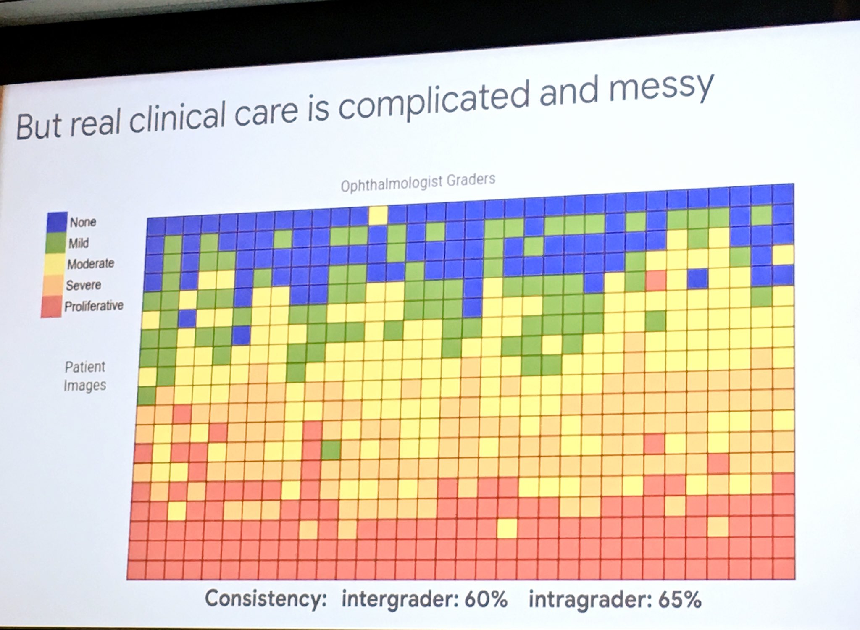
Diagnosing Diabetic Eye Disease Using Deep Learning
A slide from Jeff Dean’s Keynote in 2019 at the “Big Data in Precision Health” conference at Stanford Medicine

Slide 30
Some Applications of AI in Medicine
Diagnosing diabetic eye disease using deep learning [1]
Detecting anemia from retinal fundus images using deep learning [2]
Predicting cardiovascular risk factors from retinal fundus photographs using deep learning [3]
Extracting symptoms and their status from clinical conversations using recurrent neural networks [4]
Performing differential diagnosis using probabilistic graphical models [5]
Predicting osteoarthritis using machine learning [6]

Slide 31
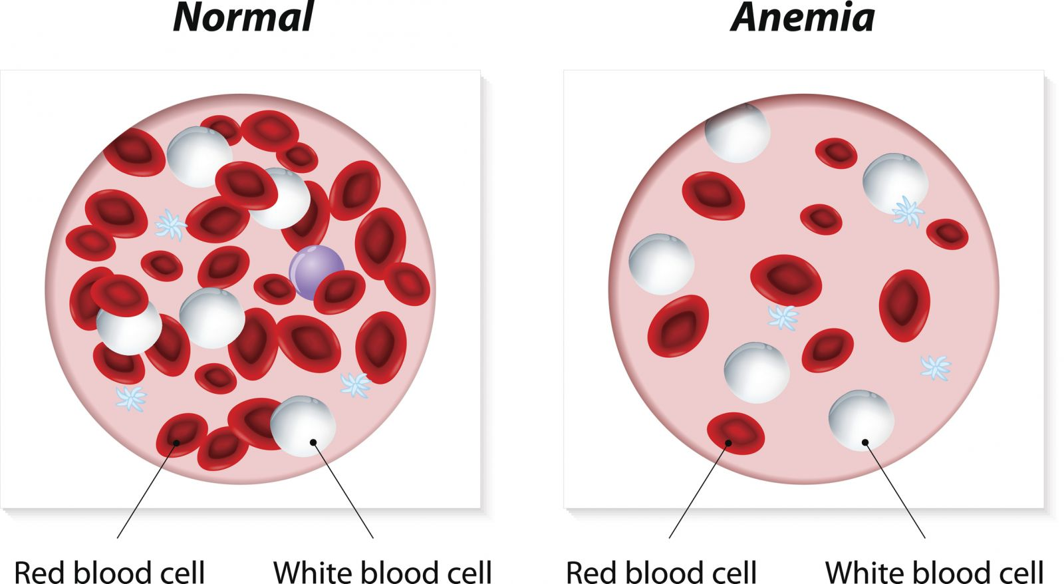
Detecting Anemia from Retinal Fundus Images Using Deep Learning
Anemia is a public health problem impacting an estimated 1.62 billion people and inducing far-reaching consequences on productivity and quality-of-life
Anemia is usually correctable; hence, timely detection and intervention are key!

Slide 32
Detecting Anemia from Retinal Fundus Images Using Deep Learning
The most reliable indicator of anemia is hemoglobin concentration (Hb), which is measured using a venous or capillary blood sample
This is invasive & painful and can cause infection in patients & healthcare workers, let alone that it generates biohazardous waste
Noninvasive procedures are currently available or under exploration, but they are less accurate than the gold standard and represent trade-offs between invasiveness, time, cost and accuracy

Slide 33
Detecting Anemia from Retinal Fundus Images Using Deep Learning
Interestingly, anemia of sufficient severity has been known to manifest characteristic signs in the fundus of the eye
E.g., Retinopathy is observed in 28.3% of patients with anemia and/or thrombocytopenia, and low Hb was associated with the presence of retinopathy
The low prevalence of retinopathy among patients with anemia limits its potential sensitivity as a stand-alone diagnostic feature
Hence, fundus photographs have not been used to either detect anemia or quantify more precise Hb levels

Slide 34
Detecting Anemia from Retinal Fundus Images Using Deep Learning
Google showed that Hb can be quantified and anemia can be detected using fundus photographs and deep learning
They conducted a study on data from the UK Biobank with a total of 114,205 fundus images from 57,163 study participants
Among all the participants, 3.7% had anemia, with Hb ranging from 6.4 g dl^{–1} to 19.6 g dl^{–1}
Metadata such as demographics, sex, and age were considered

Slide 35
Detecting Anemia from Retinal Fundus Images Using Deep Learning
To this end, they developed 3 machine learning models:
A metadata-only (linear regression– will be discussed later in the semester) model to ensure that their predictors were not solely predicting Hb measurements based on age and sex
A fundus-only deep learning model, which uses fundus images
A combined model, which uses both metadata and fundus images

Slide 36
Detecting Anemia from Retinal Fundus Images Using Deep Learning
Results of the fundus-only model:
Red and white areas represent regions the model was positively influenced by
Red indicates a stronger contribution than white
Blue regions have little to no contribution towards the prediction
The model correctly predicts moderate anemia in each case

Slide 37
Detecting Anemia from Retinal Fundus Images Using Deep Learning
A Preamble: Receiver Operator Characteristic (ROC) and Area Under the Curve (AUC)
No Anemia
Each circle represents a person
Anemia
Hb

Slide 38
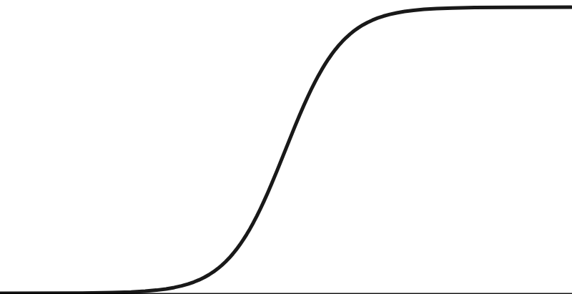
Detecting Anemia from Retinal Fundus Images Using Deep Learning
A Preamble: Receiver Operator Characteristic (ROC) and Area Under the Curve (AUC)
No Anemia
A logistic regression curve
(will be covered later in the semester)
Anemia
Hb

Slide 39
Detecting Anemia from Retinal Fundus Images Using Deep Learning
A Preamble: Receiver Operator Characteristic (ROC) and Area Under the Curve (AUC)
1
When we build a logistic regression model (or classifier) the y-axis is converted to
a probability that indicates whether a person has anemia
0
Hb

Slide 40
Detecting Anemia from Retinal Fundus Images Using Deep Learning
A Preamble: Receiver Operator Characteristic (ROC) and Area Under the Curve (AUC)
1
But to do classification, we need to transform probabilities into classes (Anemia vs. No Anemia)
0
Hb

Slide 41
Detecting Anemia from Retinal Fundus Images Using Deep Learning
A Preamble: Receiver Operator Characteristic (ROC) and Area Under the Curve (AUC)
1
For this sake, we can use
a threshold with a certain
value (e.g., if pr <= 0.5,
the person has Anemia;
else, No Anemia)
0
Hb

Slide 42
Detecting Anemia from Retinal Fundus Images Using Deep Learning
A Preamble: Receiver Operator Characteristic (ROC) and Area Under the Curve (AUC)
1
For this sake, we can use
a threshold with a certain
value (e.g., if pr <= 0.5,
the person has Anemia;
else, No Anemia)
Threshold = 0.5
Probability <= 0.5 ➔ Anemia
0
Hb

Slide 43
Detecting Anemia from Retinal Fundus Images Using Deep Learning
A Preamble: Receiver Operator Characteristic (ROC) and Area Under the Curve (AUC)
1
For this sake, we can use
a threshold with a certain
value (e.g., if pr <= 0.5,
the person has Anemia;
else, No Anemia)
Probability > 0.5 ➔ No Anemia
Threshold = 0.5
0
Hb

Slide 44
Detecting Anemia from Retinal Fundus Images Using Deep Learning
A Preamble: Receiver Operator Characteristic (ROC) and Area Under the Curve (AUC)
In this example, and with a threshold/cutoff of 0.5,
all the people with no anemia
(i.e., represented by the green
circles) will be classified as No Anemia
1
For this sake, we can use
a threshold with a certain
value (e.g., if pr <= 0.5,
the person has Anemia;
else, No Anemia)
Threshold = 0.5
0
Hb

Slide 45
Detecting Anemia from Retinal Fundus Images Using Deep Learning
A Preamble: Receiver Operator Characteristic (ROC) and Area Under the Curve (AUC)
1
For this sake, we can use
a threshold with a certain
value (e.g., if pr <= 0.5,
the person has Anemia;
else, No Anemia)
Threshold = 0.5
… and all the people with anemia (i.e., represented by the red circles) will be classified as Anemia
0
Hb

Slide 46
Detecting Anemia from Retinal Fundus Images Using Deep Learning
A Preamble: Receiver Operator Characteristic (ROC) and Area Under the Curve (AUC)
1
But, what if we change the threshold to 0.2?
Threshold = 0.5
0
Hb

Slide 47
Detecting Anemia from Retinal Fundus Images Using Deep Learning
A Preamble: Receiver Operator Characteristic (ROC) and Area Under the Curve (AUC)
1
But, what if we change the threshold to 0.2?
Probability > 0.2 ➔ No Anemia ➔ False Negative
Threshold = 0.2
0
Hb

Slide 48
Detecting Anemia from Retinal Fundus Images Using Deep Learning
A Preamble: Receiver Operator Characteristic (ROC) and Area Under the Curve (AUC)
1
What if we change the threshold to 0.9?
Threshold = 0.2
0
Hb

Slide 49
Detecting Anemia from Retinal Fundus Images Using Deep Learning
A Preamble: Receiver Operator Characteristic (ROC) and Area Under the Curve (AUC)
1
Threshold = 0.9
What if we change the
threshold to 0.9?
Probability < 0.9 ➔ Anemia ➔ False Positive
0
Hb

Slide 50
Detecting Anemia from Retinal Fundus Images Using Deep Learning
A Preamble: Receiver Operator Characteristic (ROC) and Area Under the Curve (AUC)
1
What is the best threshold value?
0
Hb

Slide 51
Detecting Anemia from Retinal Fundus Images Using Deep Learning
A Preamble: Receiver Operator Characteristic (ROC) and Area Under the Curve (AUC)
1
We can consider many
threshold values and
compute the sensitivity and specificity (or alternatively precision) per each value
0
Hb

Slide 52
Detecting Anemia from Retinal Fundus Images Using Deep Learning
A Preamble: Receiver Operator Characteristic (ROC) and Area Under the Curve (AUC)
1
Afterwards, we can summarize all the results under all the threshold
values using an ROC graph
0
Hb

Slide 53
Detecting Anemia from Retinal Fundus Images Using Deep Learning
A Preamble: Receiver Operator Characteristic (ROC) and Area Under the Curve (AUC)
Afterwards, we can summarize all the results under all the threshold
values using an ROC graph
True Positive Rate
(Sensitivity)
False Positive Rate
(1- Specificity)

Slide 54
Detecting Anemia from Retinal Fundus Images Using Deep Learning
A Preamble: Receiver Operator Characteristic (ROC) and Area Under the Curve (AUC)
Afterwards, we can summarize all the results under all the threshold
values using an ROC graph
This is where
True Positive Rate =
False Positive Rate
True Positive Rate
(Sensitivity)
False Positive Rate
(1- Specificity)

Slide 55
Detecting Anemia from Retinal Fundus Images Using Deep Learning
A Preamble: Receiver Operator Characteristic (ROC) and Area Under the Curve (AUC)
ROC
Afterwards, we can summarize all the results under all the threshold
values using an ROC graph
True Positive Rate
(Sensitivity)
False Positive Rate
(1- Specificity)

Slide 56
Detecting Anemia from Retinal Fundus Images Using Deep Learning
A Preamble: Receiver Operator Characteristic (ROC) and Area Under the Curve (AUC)
Afterwards, we can summarize all the results under all the threshold
values using an ROC graph
The larger the AUC,
the better!
True Positive Rate
(Sensitivity)
AUC
False Positive Rate
(1- Specificity)

Slide 57
Detecting Anemia from Retinal Fundus Images Using Deep Learning
Using a validation dataset of 11,388 participants from the UK Biobank
The metadata-only predicted Hb with mean absolute error value (MAEV) of 0.73 and Area Under the Receiver Operating Characteristic Curve (AUC) 0.74
The fundus-image-only predicted Hb with MAEV = 0.67 & AUC = 0.87
The combined model predicted Hb with MAEV =0.63 & AUC = 0.88
The combined model predicted Hb, HCT and RBC more accurately than either the fundus-only or metadata-only models
This indicates that both, metadata and fundus images are important for accurate prediction

Slide 58
Detecting Anemia from Retinal Fundus Images Using Deep Learning
What does this study entail?
An AI approach that leverages retinal fundus images and metadata can detect anemia and quantify Hb measurements, potentially enabling automated anemia screening using fundus images
Since fundus photographs are routinely captured as part of screening for diabetic retinopathy, the ability to predict Hb from these photographs may also enable seamless anemia screening with minimal additional cost
This is important because anemia is twice as common in patients with diabetes

Slide 59
Some Applications of AI in Medicine
Diagnosing diabetic eye disease using deep learning [1]
Detecting anemia from retinal fundus images using deep learning [2]
Predicting cardiovascular risk factors from retinal fundus photographs using deep learning [3]
Extracting symptoms and their status from clinical conversations using recurrent neural networks [4]
Performing differential diagnosis using probabilistic graphical models [5]
Predicting osteoarthritis using machine learning [6]
Next Monday…

Slide 60
References
Gulshan, Varun, et al. "Development and validation of a deep learning algorithm for detection of diabetic retinopathy in retinal fundus photographs." Jama 316.22 (2016): 2402-2410.
Mitani, Akinori, et al. "Detection of anaemia from retinal fundus images via deep learning." Nature Biomedical Engineering 4.1 (2020): 18-27.
Poplin, R., et al. "Predicting cardiovascular risk factors from retinal fundus photographs using deep learning. arXiv 2017." arXiv preprint arXiv:1708.09843.
Du, Nan, et al. "Extracting symptoms and their status from clinical conversations." arXiv preprint arXiv:1906.02239 (2019).
Hammoud, M., et al. “Avey: An Accurate AI Algorithm for Self-Diagnosis”.
Kundu, Shinjini, et al. "Discovery and visualization of structural biomarkers from MRI using transport-based morphometry." NeuroImage 167 (2018): 256-275.

